Slide 1
Session 20
Swing - I

Slide 2
Review
Java Studio Enterprise 8 is an interface for users to design, develop, test, deploy and manage Java applications.
A project is a collection of files that make up a Java program.
Each and every program written in Java Studio Enterprise 8 has to be in the context of a project.
Debugging usually detects logical errors. The most common debugging tools are the breakpoints and watches.
The IDE interprets the codes as it is being written, and underlines syntax errors in the Output window.
The error messages in the output pane describe the errors.

Slide 3
Objectives
Explain the Abstract Window Toolkit (AWT)
Explain Swing
Compare AWT with Swing
Describe Swing Container components
  JFrame
  JPanel
  JScrollPane
Describe GUI Components
  JLabel
  JTextField
  JTextArea
  JButton
  JCheckBox
  JRadioButton
  JComboBox
Explain Event Listener
  Explain Inner Class and Anonymous Class
Describe Layout Manager
  Border Layout
  FlowLayout
  GridLayout

Slide 4
Overview of AWT
AWT
(Part of java foundation class)
Through
Creates GUI
java.awt package
Subsystems of AWT
Container
Contains the AWT components
Component
Graphically represented object
allows user interaction
Layout manager
Defines location and size of GUI
component
Graphics and drawing
capabilities
Graphics are drawn relative to a window
by AWT graphics methods
Fonts
Object created and constructed to
select a new font
Event
Any state change in a source
due to user interaction

Slide 5
Swing 2-1
Swing
Pluggable Look
and Feel
Drag and Drop
Java Foundation Class 1.2
(Five major packages)
Accessibility
2D

Slide 6
Swing 2-2
Wide variety of Components
Pluggable Look and Feel
MVC Architecture
Action Objects
Nested Containers
Customized Dialogs
Structured Table and Tree Components
Powerful Text Manipulations
Accessibility Support
Drag and Drop
Java 2D
Advantages
Swing

Slide 7
Swing Container Components 3-1
Swing application
Top level Container
(At least one in
Every application)
Main Window
Main display area
contains visible
components in GUI
Content pane1
Creating Top level container
Create the container
Set its size
(for frames and panels)
Set its visibility
(for frames and panels)

Slide 8
Swing Container Components 3-2
javax.swing package
Commonly used top level containers
JFrame
JPanel
JScrollPane
1. Extends java.awt.Frame class
2. Used to create windows, on which other
Swing components are placed.
3. Contains border, title and button
for closing and iconifying the window.
1. Intermediate container
2. Used to group smaller lightweight
components.
3. Works similar to content panes and
by default, panels are opaque.
Component that provides a rectangular
area for viewing a component.
Manages viewport, scrollbars, and
optional row and column heading
viewports.
Basically consists of JScrollBar, a
JViewport and the link between them.

Slide 9
Swing Container Components 3-3
Methods of JFrame class
void pack()
void setSize(int width, int height)
Dimension getSize()
void setDefaultCloseOperation(int constant)
void setTitle(String name)
String getTitle()
void setIconImage(Image img)
Methods of JPanel class
void add(Component comp)
void add(Component comp, Object o)
void remove(Component comp)
Void setLayout(LayoutManager layout)
Methods of JScrollPane class
void setViewportView(Component comp)
void setVerticalScrollBarPolicy(int const)
void setHorizontalScrollBarPolicy(int const)

Slide 10
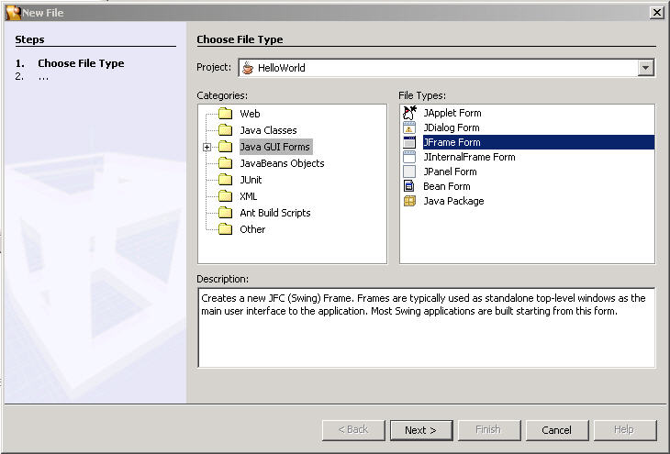
Creating a JFrame using Java Studio Enterprise 8 3-1
Select file type to create a new JFC(Swing) Frame
Click on Next

Slide 11
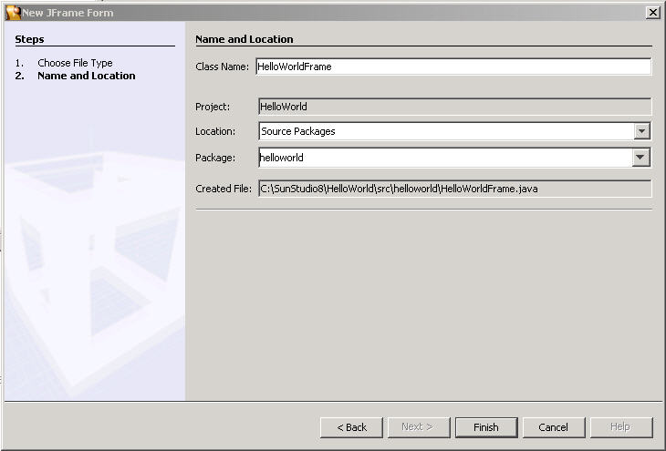
Creating a JFrame using Java Studio Enterprise 8 3-2
Type HelloWorldFrame in the Class name field

Slide 12
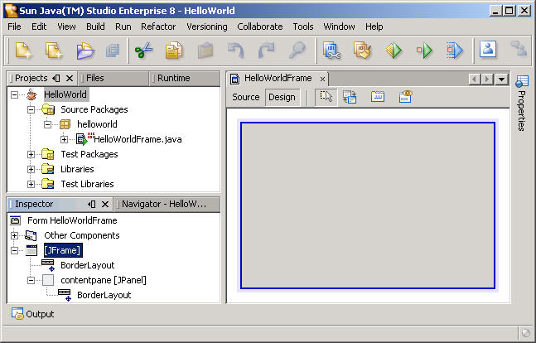
Creating a JFrame using Java Studio Enterprise 8 3-3
Highlighted JFrame
Students can refer to the generated-code given in Student’s Guide

Slide 13
Describing Swing GUI components 8-1
JLabel
Method | Description
getLabelFor() | Gets the label for the specified component.
getText() | Returns the text string that the label displays.
getVerticalAlignment() | Returns the alignment of the label's contents along the Y axis.
setIcon(Icon icon) | Defines the icon the label will display.
setLabelFor(Component c) | Sets the label for the specified component.
setText(String text) | Defines the single line of text this component will display.
Properties | Description
A label is not interactive and does not respond to any input events | Displays a label on form In Swing, labels can display text as well as images

Slide 14
Describing Swing GUI components 8-2
JTextField
Method | Description
getColumns() | Returns the number of columns in the text field.
setColumns(int columns) | Sets the number of columns in the text field, and then invalidates the layout.
setHorizontalAlignment(int value) | Sets the horizontal alignment of the text within the text field. The following constants can be used for value: JTextField.LEADING, JTextField.CENTER and JTextField.TRAILING.

Slide 15
Describing Swing GUI components 8-3
Method | Description
append(String str) | Appends the given text to the end of the document.
getColumns( ) | Returns the number of columns in the text area.
getColumnWidth( ) | Gets the column width.
getLineCount( ) | Determines the number of lines contained in the area.
getLineEndOffset(int line) | Determines the offset of the end of the given line.
getLineWrap( ) | Gets the wrapping policy of the text area.
getRows( ) | Returns the number of rows displayed by the text area.
insert(String str, int pos) | Inserts the specified text at the specified position.
setColumns(int columns) | Sets the number of columns displayed by this text area.
setFont(Font f) | Sets the font for the text area.
setLineWrap(boolean Wrap) | Sets the line wrapping policy for the text area.
setRows(int rows) | Sets the number of rows for the text area.
replaceRange(String str, int start, int end) | Replaces the text with the text specified in str between the indicated position specified by start and end.
JTextArea
Properties | Description
JTextArea component accepts several lines of text from the user. | JTextArea allows the user to edit the text that is entered.

Slide 16
Describing Swing GUI components 8-4
JButton
Properties | Description
JButton class is derived from the avax.swing.AbstractButton class which, in turn extends from the JComponent class. | 1. JButton object consists of a text label, image icon or both, that describes the purpose of the button and an empty area around the text/icon with a border.

Slide 17
Describing Swing GUI components 8-5
Method | Description
isDefaultButton( ) | Returns whether or not the corresponding button is the default button on the RootPane.
isDefaultCapable( ) | Returns whether or not the corresponding button is capable of being the default button on the RootPane.
setDefaultCapable(boolean defaultCapable) | Sets whether or not the corresponding button is capable of being the default button on the RootPane.
setRolloverIcon(Icon img) | Displays the specified icon when the cursor passes over it.
setSelectedIcon(Icon img) | Displays the icon specified by img when the button is selected.

Slide 18

Describing Swing GUI components 8-6
Other Components
JCheckBox
JRadioButton

Slide 19
Describing Swing GUI components 8-7
JComboBox
Properties | Description
1. In Swing, the combo box is represented by the JComboBox class. | 1. ComboBox is a combination of a text field and drop-down list that lets the user either type in a value or select it from a list that is displayed to the user.

Slide 20
Describing Swing GUI components 8-8
JComboBox
Method | Description
addItem(Object obj) | Adds an item to the item list.
getItemAt(int index) | Returns the list item at the specified index.
getItemCount() | Returns the number of items in the list(as an object). The index used is a zero based index, that is, to get the first item, the method call should be getItemAt(0).
getSelectedItem() | Returns the currently selected item as an object.
getSelectedIndex() | Returns the index position of the currently selected item.
showPopup() | Causes the combo box to display its popup window.

Slide 21
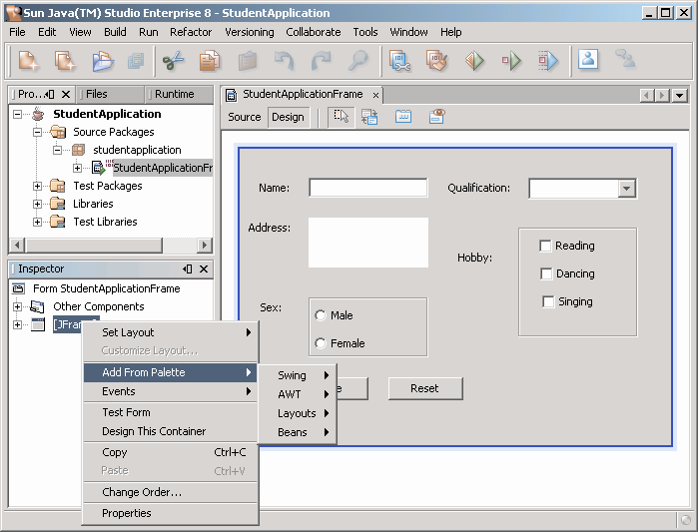
Creating Application containing
Swing GUI components 5-1
Right Click on the JFrame option in the Inspector window
Select any one option

Slide 22
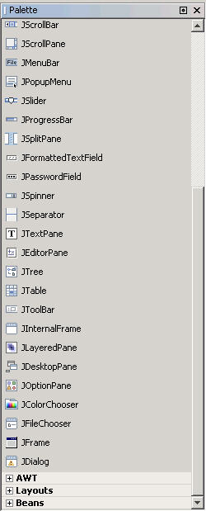
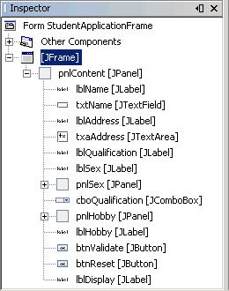
Creating Application containing
Swing GUI components 5-2
Select component
Components get added to the panel as seen from the Inspector pane.

Slide 23
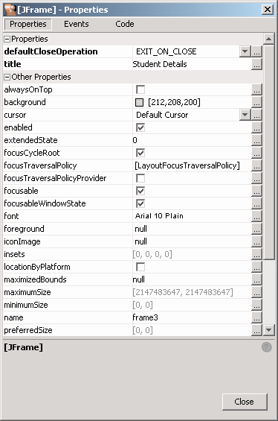
Creating Application containing
Swing GUI components 5-3
Properties window of JFrame
Click on the tab to change the property

Slide 24
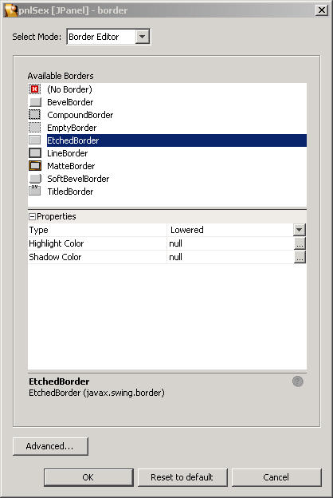
Creating Application containing
Swing GUI components 5-4
Set the Border property of the pnlHello and pnlSex to
“EtchedBorder” from the properties window of the JPanel

Slide 25
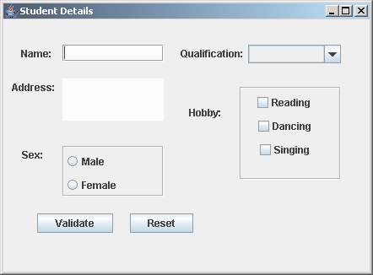
Creating Application containing
Swing GUI components 5-5
Output of the Student Application

Slide 26
Event Handlers 3-1
User Interaction
Mouse click
Press / Release Keyboard
Change in state of Object
Calls for event
handling
!
Event
Determine type of event that took place
Determine component that generated event
Write appropriate code to handle event

Slide 27
Event Handlers 3-2
Event Delegation Model
Source
Listener
Event
GUI component In Swing
Propagated
Adapter Object
Instance of Event
Method
Passed through

Slide 28
Event Handlers 3-3
Event Class | Interface
ActionEvent | ActionListener
AdjustmentEvent | AdjustmentListener
ComponentEvent | ComponentListener
FocusEvent | FocusListener
ItemEvent | ItemListener
WindowEvent | WindowListener
TextEvent | TextListener
MouseEvent | MouseListener, MouseMotionListener
KeyEvent | KeyListener

Slide 29
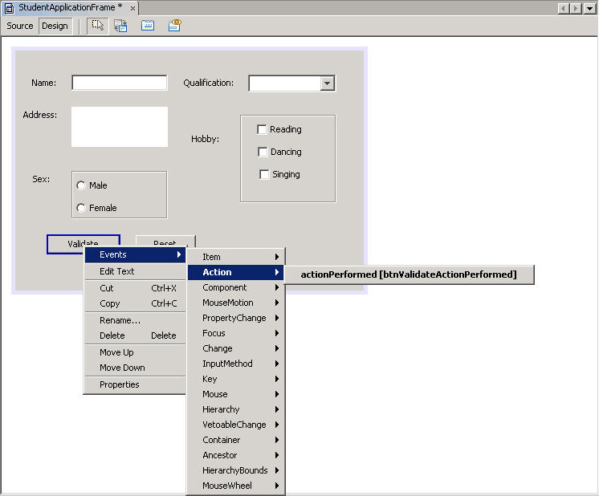
Implementing Event Handlers 2-1
1. Right click on the Validate button
public void btnValidateActionPerformed(ActionEvent e){}
3. Write the actual code for the events for that component in the method generated as shown above.
2. Click on the Event tab of Inspector to
display the events for that component

Slide 30
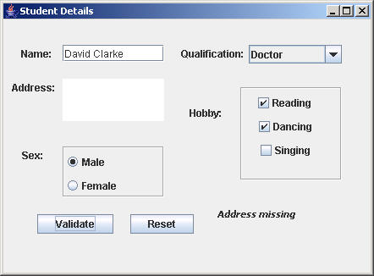
Implementing Event Handlers 2-2
Output of the Event handling code – Text is set in a label from the actionPerformed() method of the ActionListener for the Validate button.
1. Click on the Validate button to generate an ActionEvent

Slide 31
Layout Manager
Screen components on a user interface can be arranged in a serial fashion or grid-like manner using Layout manager.
The layout manager classes are a set of classes that
    Implement java.AWT.LayoutManager interface
    Help to position the components in a container
The various layouts available in Java are as follows:
    FlowLayout
    BorderLayout
    GridLayout

Slide 32
BorderLayout Manager 3-1
North
PAGE_START
L
I
N
E
_
S
T
A
R
T
L
I
N
E
_
E
N
D
West
CENTER
East
Container
PAGE_END
South

Slide 33
BorderLayout Manager 3-2
North
PAGE_START
Method | Description
getHgap( ) | Returns the horizontal gap between components.
getVgap( ) | Returns the vertical gap between components.
setHgap(int hgap) | Sets the horizontal gap between components to the value specified.
setVgap(int vgap) | Sets the vertical gap between components to the value specified.
L
I
N
E
_
S
T
A
R
T
L
I
N
E
_
E
N
D
West
CENTER
East
Container
PAGE_END
South

Slide 34
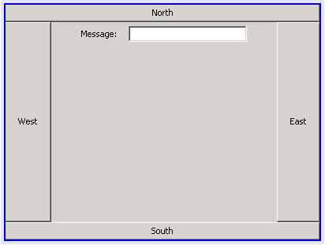
BorderLayout Manager 3-3
Select the JFrame.
The layout property of the JFrame is, by default, BorderLayout.
Select JPanel from the Swing category in the component palette.
Add JPanels to the North, South, East and West.
Change the properties using the Inspector and name the variables as pnlCenter etc.
Add a JButton to each of the JPanels and name them as per their location.
Add a JLabel to the JPanel, pnlCenter and set the text to “Message”.
Add a JTextField to the JPanel, pnlCenter.
Select the North button on the design view. In the Inspector window, right-click and add events.
Click on the actionPerformed event in the popup window.
Go to the source tab and add code for the actionPerformed method.
Similarly add action events for all the buttons
Build and run the application
btnNorth.addActionListener(new java.awt.event.ActionListener() {
public void actionPerformed(java.awt.event.ActionEvent evt) { btnNorthActionPerformed(evt); }
});
public void btnNorthActionPerformed(ActionEvent e) {
txtMessage.setText("North Button Pressed");
}
public void btnWestActionPerformed(ActionEvent e) {
txtMessage.setText("West Button Pressed");
}
public void btnSouthActionPerformed(ActionEvent e) {
txtMessage.setText("South Button Pressed");
}
public void btnEastActionPerformed(ActionEvent e) {
txtMessage.setText("East Button Pressed");
}
Add code to display a message in the txtMessage field
Code generated for the actionPerformed method
Add code for the actionPerformed event of btnWest
Add code for the actionPerformed event of btnSouth
Add code for the actionPerformed event of btnEast
Demonstration: Creating a Java Studio Enterprise 8 application using Layout manager.

Slide 35
FlowLayout Manager 2-1
Upper left
Corner
FlowLayout is Default Layout
manager for panels
components arranged serially
Lower right
Corner
Vertical or horizontal
padding
Container

Slide 36
FlowLayout Manager 2-2
Upper left
Corner
FlowLayout is Default Layout
manager for panels
Method | Description
getAlignment( ) | Gets the alignment for the layout.
getHgap( ) | Gets the horizontal gap between components.
getVgap( ) | Gets the vertical gap between components.
setAlignment( int align) | Sets the alignment for the specified layout.
setHgap(int hgap) | Sets the horizontal gap for the specified layout.
setVgap(int vgap) | Sets the vertical gap for the specified layout.
components arranged serially
Lower right
Corner
Vertical or horizontal
padding
Container

Slide 37
GridLayout Manager2-1
Specifying the number of rows and columns in
the grid creates the GridLayout
Columns
Components are of
same size
Components are resized
to fit their cell
Rows

Slide 38
GridLayout Manager 2-2
Method | Description
getColumns( ) | Gets the number of columns in the corresponding layout.
getRows( ) | Gets the number of rows in the corresponding layout.
getHgap( ) | Gets the horizontal gap for the corresponding layout.
getVgap( ) | Gets the vertical gap for the corresponding layout.
setColumns(int cols) | Sets the number of columns to the specified number in the corresponding layout.
setHgap(int hgap) | Sets the horizontal gap to the value specified in the corresponding layout.
setVgap(int vgap) | Sets the vertical gap to the value specified in the corresponding layout.
setRows(int rows ) | Sets the number of rows in the corresponding layout to the specified value.
Specifying the number of rows and columns in
the grid creates the GridLayout
Columns
Components are of
same size
Components are resized
to fit their cell
Rows

Slide 39
Summary
A Graphical User Interface is used to accept input in a user-friendly manner.
Java Foundation Classes extends Abstract Window ToolKit(AWT) and contains improved user interface called the Swing Components.
A container object is a component that can contain other Swing components. A container is responsible for laying the components that it contains. Commonly used containers are JFrame, JPanel and JScrollPane.
A component is placed on a user interface and can be made visible or resized. The commonly used components are JLabel, JTextField, JTextArea, JButton, JCheckBox, JRadioButton and JComboBox.
To handle events, event handlers are available that are to be manipulated to perform the desired action.
A Layout Manager automatically positions components within a container.

